Slide 1


LIFE UNDER WATER
IBM AI Agent INTERNSHIP Project
Exploring the role of carbon credits in marine conservation

Slide 2



Presented by : era
Group members :
Anjali Patlan
Yogita Dahiya
Neha Gahlawat
Ishita Dhiman
Priti Panchal
College : Hindu Girls College

Slide 3
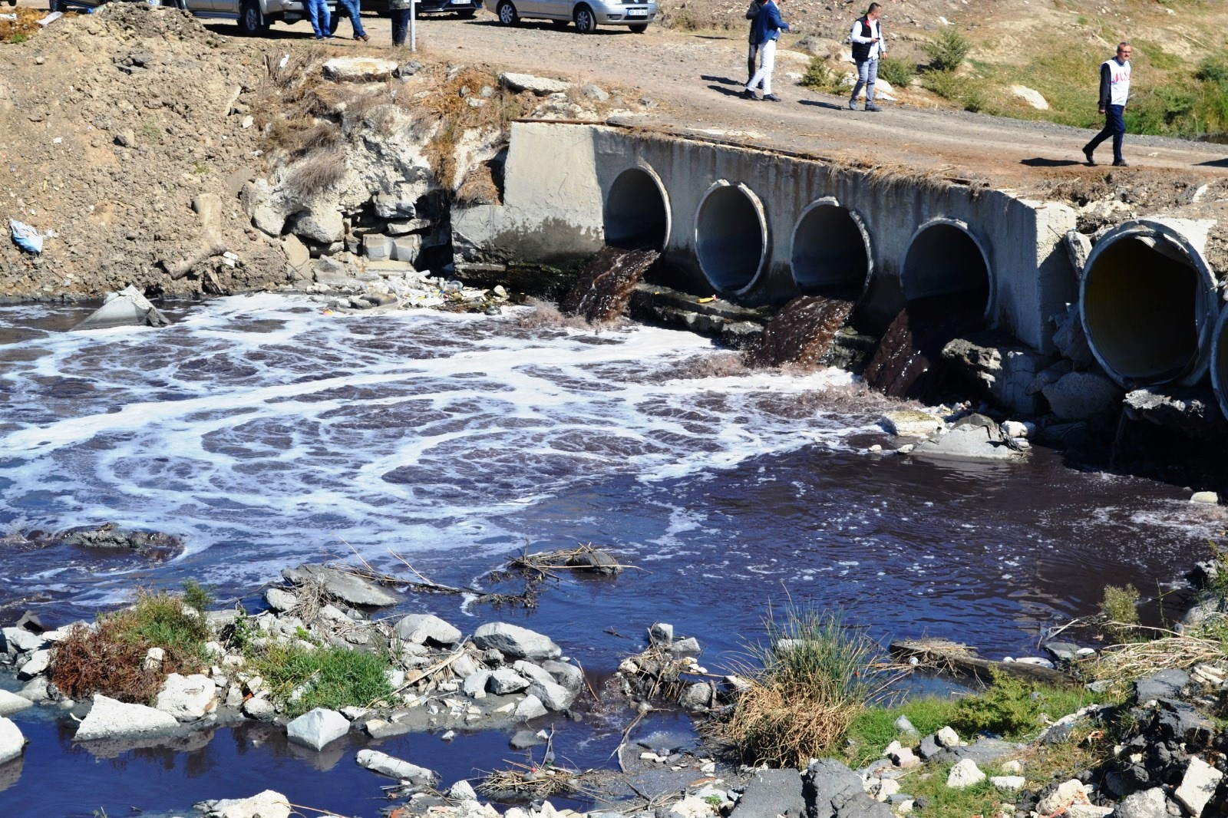

Introduction
The ocean is one of the earth's most vital ecosystems-covering over 70% of the planet's surface and playing a key role in regulating the global climate. It produces oxygen, absorbs vast amounts of carbon dioxide, and supports millions of species.
However, the health of our oceans is under threat. Pollution, overfishing, rising temperatures, and habitat destruction are damaging marine life and weakening the ocean's ability to protect the planet.
* This project explores how carbon credits, a market-based tool to reduce greenhouse gas emissions, can be applied to marine conservation efforts. Carbon credits assign financial value to activities that reduce or offset emissions. *

Slide 4
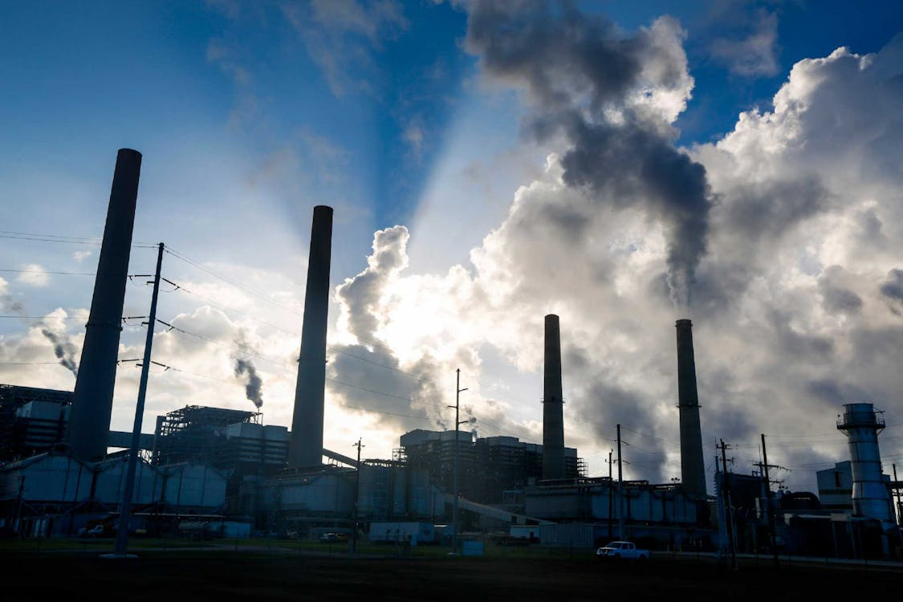

Problem statement
These human activities degrade vital habitats, threaten biodiversity, and release stored carbon, worsening climate change. Carbon credits offer a financial incentive for conservation and restoration, generating revenue for marine protection efforts. However, challenges exist in accurately measuring blue carbon's impact and ensuring the effectiveness of such projects, hindering their full potential.
Industries harm marine life through pollution, habitat destruction from coastal development, and overfishing. Carbon dioxide emissions lead to ocean acidification, making it difficult for organisms like corals and shellfish to thrive.
.

Slide 5
Why it matters ?!
Preserving life under water is not only about saving marine animals. It's about protecting the balance of the earth's ecosystems and ensuring a sustainable future. By integrating economic tools like carbon credits into conservation models, we can encourage businesses, governments, and communities to invest in the health of our oceans.

Slide 6
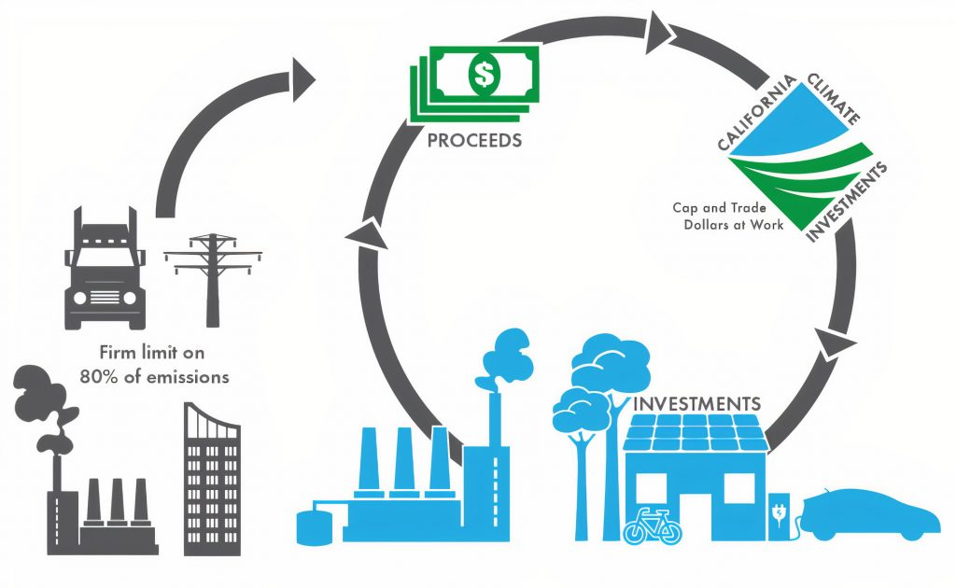

Sustainable development goal
Goal chosen : Life Below Water
Industrial pollution and overexploitation damage marine life and key ocean ecosystems. This harms sea creatures and reduces the ocean's role in mitigating climate change.
Carbon credits fund conservation, protecting ocean health and maintain one of the most important thing THE CLIMATE.
.
This Photo by Unknown Author is licensed under CC BY

Slide 7

Data collection and preprocessing
Data Collection : Data collection is performed by accessing a Google Sheets spreadsheet that contains responses from a Google Form. The script fetches the spreadsheet data in CSV format via a specific export URL. This fetching process occurs every 30 seconds, enabling near real-time acquisition of newly submitted user data.
Preprocessing : Once the raw data is fetched, preprocessing steps are applied to prepare it for modeling. The script renames long and complex column headers to concise, readable names for easier manipulation. It removes any rows that have missing critical values such as email, energy, fuel, or production data to ensure data quality. Numeric input values sometimes include commas as thousand separators; these commas are removed, and the values are converted to floating-point numbers for numerical computations. This ensures the data fed into the model is clean and consistent.

Slide 8
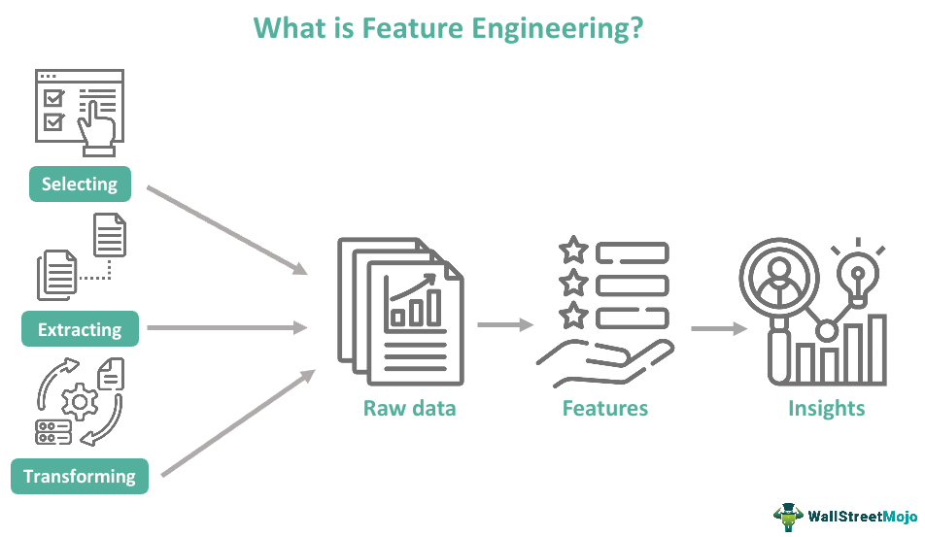

Feature engineering
The feature engineering step in this workflow is minimal. The model directly uses three input features provided by the users: energy consumed (in MWh), fuel used (in litres), and production output (in tons). No additional transformations, combinations, or derived features are created. The focus is on leveraging raw input features to predict CO₂ emissions.

Slide 9

Model development
Main technique: This program applies multiple linear regression to forecast carbon dioxide (CO₂) emissions based on factory operation data (energy, fuel, production). This is a standard statistical and machine learning technique appropriate for linear modeling between inputs and a continuous target variable.
Alternative and complementary methods (industry practice):
Support vector regression (SVR): suitable for linear and non-linear relationships, stable with small-to-medium-sized datasets.
Random forest regression: manages complicated, non-linear interactions and is stable against overfitting.
Neural networks and deep learning (e.g., LSTM): for larger data or time series data, particularly when capturing long-term dependencies and non-linearities is essential.
.

Slide 10
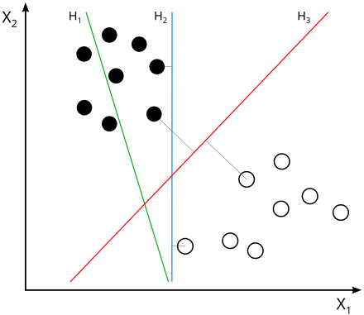
Algorithm and workflow design
Step-by-step:
Data Preparation: Input features (energy consumed, fuel utilized, production) and output variable (CO₂ emissions) are organized into a DataFrame.
Model Training: Linear regression model is trained on past data, acquiring coefficients best fitting the relation between operational parameters and emissions.
Prediction: From new factory input data, the model calculates predicted CO₂ emissions.
Categorization: With respect to emission levels, emissions are categorized as "Low", "Moderate", or "High".
Credit Calculation: Compares actual or forecasted emissions to a fixed allowable amount, reporting how many carbon credits are obtained or needed.
Workflow Management: The langgraph StateGraph controls the system's state changes, guiding flow from initial data entry to last decision nodes.
.

Slide 11

Testing
Formal testing procedures such as cross-validation or use of a separate validation set are not included in the current script. However, the script contains error handling mechanisms that manage exceptions arising from invalid input data, such as non-numeric or missing values. It also handles potential failures in the email sending process by logging errors. These measures help maintain robustness during operation but do not substitute for comprehensive model evaluation.

Slide 12

Tools and Resources Used
Programming language: python
Data manipulation: pandas (tabular data manipulation and analysis)
Machine learning: scikit-learn (model training, prediction, and metrics)
Workflow orchestration: langgraph (for state machine-based workflow orchestration)
Yagmail for simplifying SMTP email sending via Gmail,
Google Sheets for collecting and storing form submissions, and
Gmail SMTP as the email server for delivering reports.
Additionally, the environment is configured to securely manage sensitive information like Gmail app passwords.

Slide 13


Effectiveness of the model
Functionality: This application provides live CO₂ emission forecasts from input data and provides actionable insights in carbon credits.
Scalability: The state-based, modular workflow (through langgraph) allows straightforward growth with additional intricate models or business rules.
Extensibility: The platform can be extended with more advanced datasets, different algorithms, or external data such as climate/market indicators for enhanced accuracy.
Industry relevance: Predictive models such as these are central to emissions management systems of sustainability-tech firms, government reporting, and eco-certification processes.

Slide 14
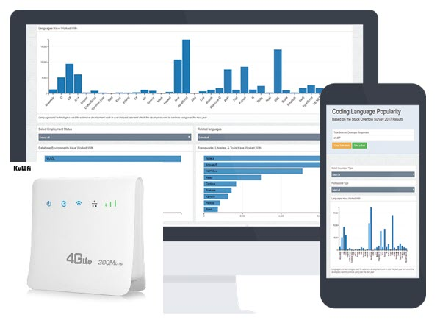
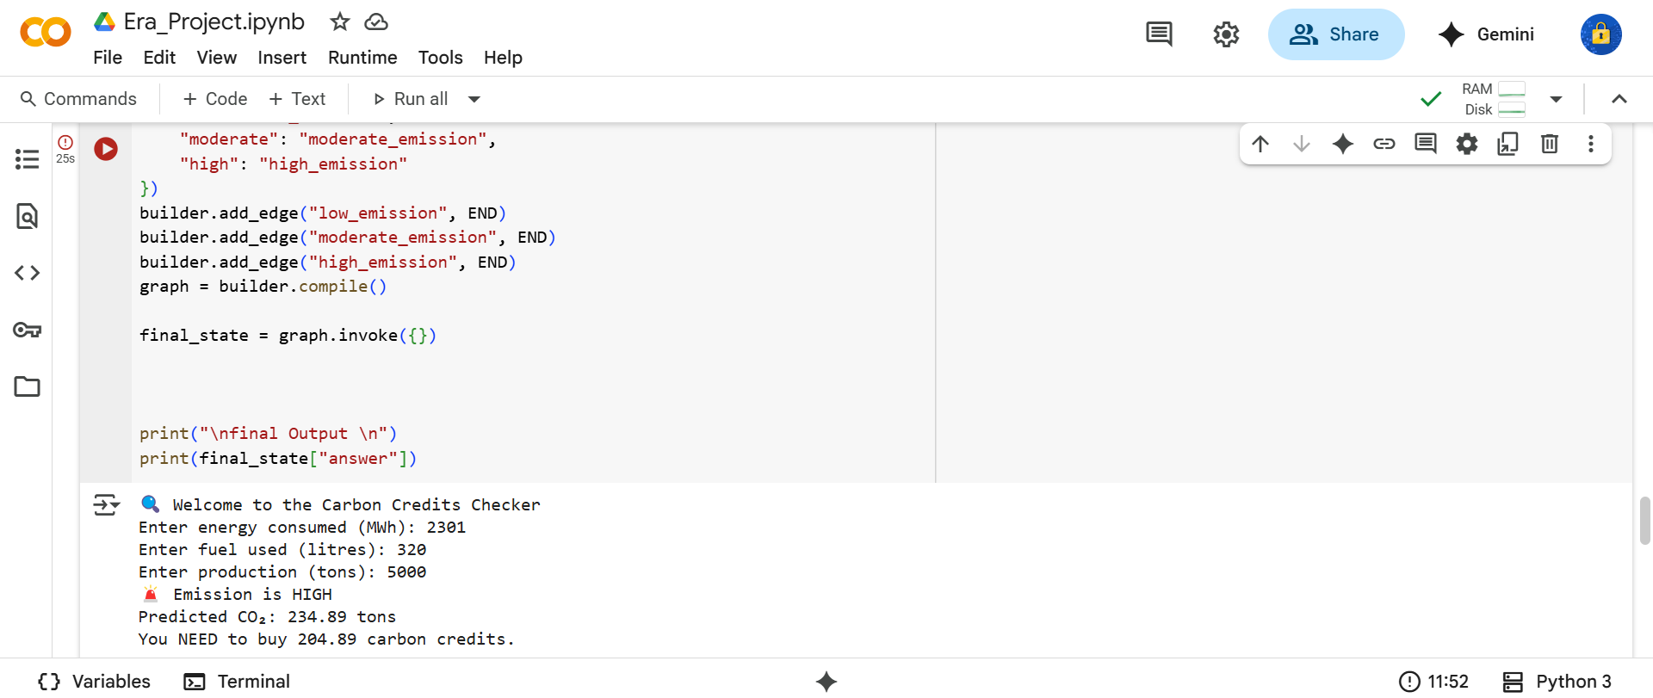
Model outcome

Slide 15

Outcome explained
.
The implemented system automates the workflow of collecting user input data, predicting carbon emissions, calculating available carbon credits or deficits, and emailing detailed personalized reports. It prevents duplicate email reports by tracking already notified users, ensuring efficient communication. The script runs continuously, providing near real-time updates and handling unexpected data or connection issues gracefully. Overall, it serves as a practical tool to help users monitor their carbon footprint and manage their carbon credit status effectively.

Slide 16


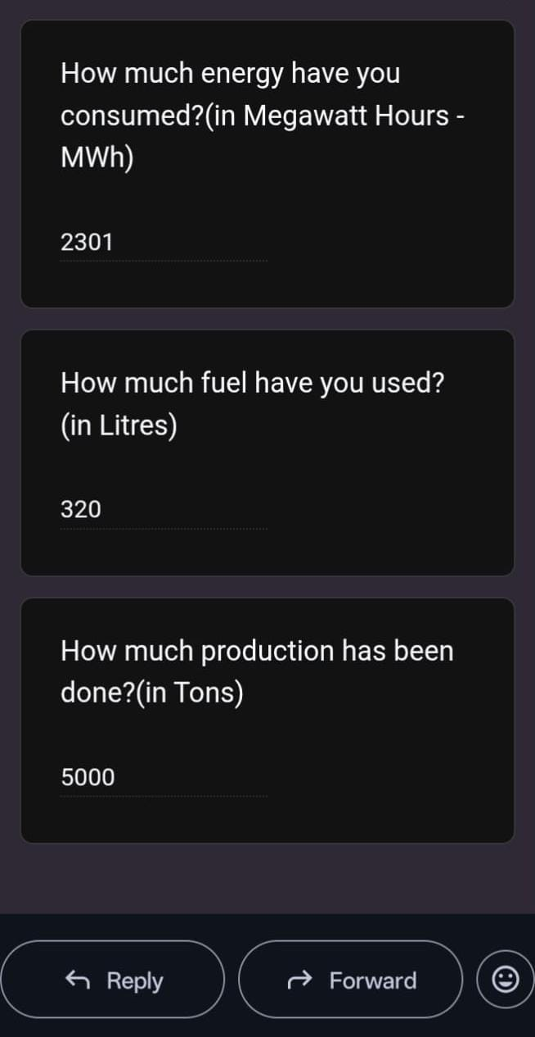
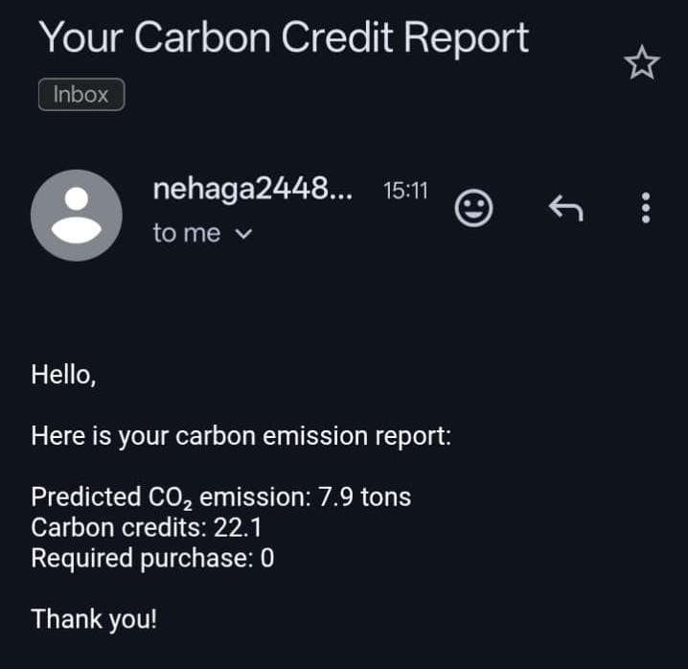
Input and output

Slide 17
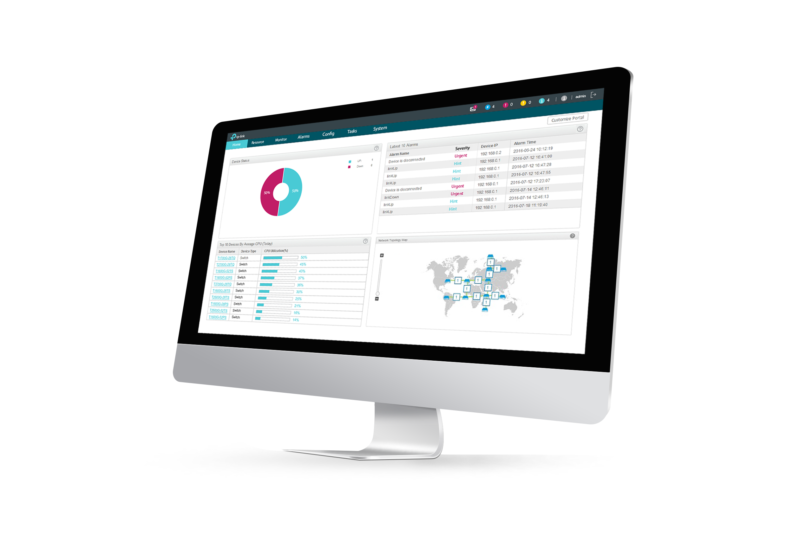
Link to model and form
Direct link:
To model : https://colab.research.google.com/drive/1orEmRB-JeQLsnxG2uaZbfdkUEIRZVqQS#scrollTo=kRR6kfCApoIf
To Training of Model : https://colab.research.google.com/drive/1f0qAboYKdHkRQnTFZ8HHXLFA1OWIbYec
To form : https://docs.google.com/forms/d/e/1FAIpQLScEReVlvdw93XiosDxNANyPXld5O68PvYuoOwrr3P56Go9mxg/viewform

Slide 18

Conclusion
In summary: This program is a prototypical data science pipeline for emission-based decision making that uses linear regression as an MVP (minimum viable product) but CAN BE SCALED TO BEST-PRACTICE APPROACHES WITH MORE DATA, more SOPHISTICATED ALGORITHMS, and stringent model assessment.

